Slide 1


Slide 2

Brainwriting
Course Code : MSTS502P
Course Title :
Credits : 1
Prerequisites : NA
Antirequisites : NA

Slide 3
Introduction
Slots Allotted :
3hours/week[theory]
Timings:

Slide 4

Introduction
Briefly introduce the concept of brainwriting.
Mention its significance in problem-solving and
idea generation.
State the objectives of the presentation.

Slide 5
What is Brainwriting?
Define brainwriting as a creative technique.
Highlight its non-verbal and written nature.
Mention how it differs from brainstorming.

Slide 6

History of Brainwriting
Provide a brief history or origin of brainwriting.
Mention any notable contributors or developments.

Slide 7
Why Use Brainwriting?
Discuss the benefits of using brainwriting:
Encourages equal participation
Reduces social pressure
Increases idea generation
Enhances creativity

Slide 8
How Does Brainwriting Work?
Explain the steps involved in brainwriting:
Set a clear problem statement or topic.
Distribute blank sheets of paper or digital documents to participants.
Participants write down their ideas silently.
Ideas are circulated and expanded upon by others.

Slide 9
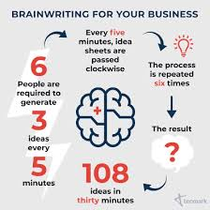
Variations of Brainwriting
Discuss different variations of brainwriting techniques:
6-3-5 Brainwriting
Mind Mapping
Round Robin Brainwriting

Slide 10
Tips for Successful Brainwriting
Share tips and best practices for effective brainwriting sessions:
Use a timer.
Encourage creativity.
Avoid criticism during the session.
Collect and organize ideas.

Slide 11
Real-Life Applications
Provide examples of situations where brainwriting can be beneficial:
Product development
Marketing strategies
Problem-solving in teams

Slide 12
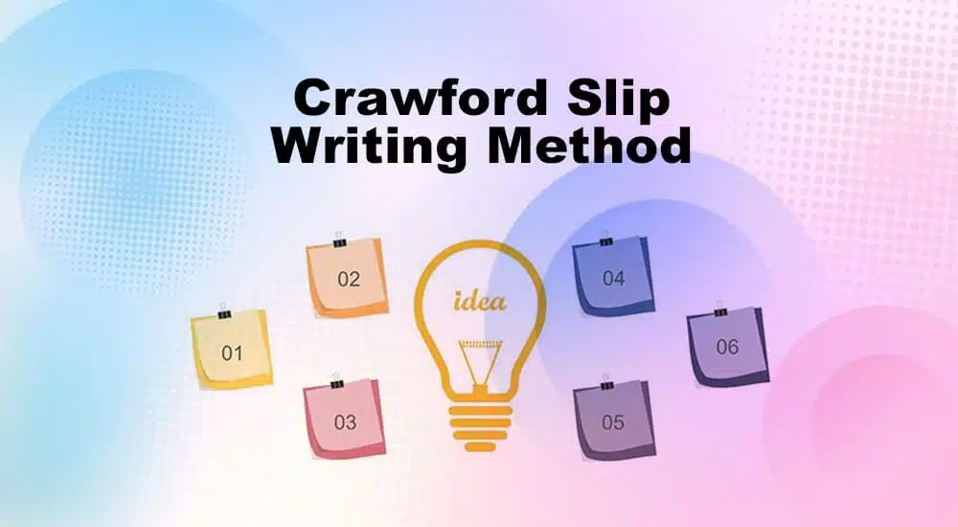
Crawfords slip writing approach
Crawford's Slip Writing Approach is a technique used to facilitate idea generation and capture thoughts quickly and efficiently.

Slide 13
It's particularly helpful when you want to brainstorm or document ideas, especially in a group setting.
The approach involves using slips of paper or digital equivalents to jot down individual thoughts or ideas, each on its separate slip.

Slide 14
Basic steps to implement this approach:
Prepare the Slips
Set the Stage
Generate Ideas
Quantity Over Quality
Time Limit
Collect the Slips
Review and Group
Discussion and Selection
Action Plan

Slide 15

1.Prepare the Slips:
You'll need a supply of small slips of paper or digital note-taking tools. Each slip should be just large enough to capture a single idea or though

Slide 16

2.Set the Stage:
If you're in a group, establish the purpose of the session and any specific topic or question you want to address. If you're working individually, clarify your goal or the problem you want to solve.

Slide 17

3.Generate Ideas:
Encourage participants (or yourself) to brainstorm freely. Whenever someone has an idea, they should write it down on a slip of paper. Stress the importance of brevity – each slip should contain only one idea or concept.

Slide 18

4.Quantity Over Quality:
During this phase, emphasize the quantity of ideas generated rather than evaluating their quality. This approach encourages a broad range of thoughts.

Slide 19
5.Time Limit:
Set a time limit for the idea generation phase. This will help maintain a sense of urgency and keep participants focused.
6.Collect the Slips:
After the idea generation phase, collect all the slips of paper or digital notes. Make sure they are mixed up or shuffled to maintain anonymity if necessary.

Slide 20

7.Review and Group:
Examine each slip one by one. If you're working in a group, this can be done collectively. Group similar ideas together as themes or categories emerge.

Slide 21

8.Discussion and Selection:
Discuss the grouped ideas, considering their value and feasibility. This discussion can lead to the selection of the best ideas or the identification of potential solutions.

Slide 22

9.Action Plan:
Determine the next steps or actions based on the ideas that were discussed and selected.

Slide 23

Benefits of Crawfords slip writing
The Slip Writing Approach is effective because it promotes divergent thinking during the idea generation phase and convergent thinking during the idea evaluation phase.

Slide 24

This technique can be adapted to various contexts, from business brainstorming sessions to creative writing workshops and problem-solving in everyday life.

Slide 25
Thank You

